Slide 1


Project Name: Bank marketing data
Group Number : 10
Group members:
G. Paul Abhishek
G. Pravalika
T.Krishna Prasad
Pranathi Dehpande
S. Yugender
B. Navneetha

Slide 2

Background:
Every bank needs customers for depositing, applying loan etc. the story of this bank is same. It’s working hard to attract customers for subscribing a term deposit. Term deposits are a low-risk way to invest your money and earn a fixed rate of interest. The employees are making calls with different categories of people and convincing them to subscribe. The data is related with direct marketing campaigns (phone calls) of a Portuguese banking institution. We are here to help the bank for analyzing the data and making predictions which type of customers should we attract to get more subscribers
Objective:
The classification goal is to predict if the client will subscribe a term deposit. By predicting it we can help the bank to make the work easier, productive, efficient and faster. Indirectly we can save their money. The goal is to target those customers who are likely interested in term deposit
Path:
The dataset is binary dependent variable. Team followed a standard Machine Learning algorithm (logistic regression) development process. We used python coding to make our analysis easier

Slide 3
Data and Data quality check
In the data we have 17 attributes and 42511 instances
The main attributes to be noticed are age, job, marital, education, default, housing, loan, campaign, y
The dataset’s outcome is a binary data set(yes/no)
Luckily in the data set, there were no missing values
Output variable : ‘y’
Input variable : remaining attributes

Slide 4

Specific data types in data frame
Categorical variables | Numeric variables
job | Age
marital | Duration
Education | Campaign
Default | Pdays
Housing | Previous
Loan | Emp_var_rate
Contact | Cons_price_idx
month | Cons_conf_idx
day_of_week | Euribor3m
poutcome | Nr_employed
y

Slide 5
How many people subscribed ?
Conditional Analysis
In performing exploratory data analysis, it is important to be able to select subsets of data to perform analysis or comparisons.
The average age of people contacted
40
451
How many people did not subscribe ?
The minimum age of people contacted
18
3668
What is the age group frequently contacted ?
The maximum age of people contacted
88
25-50

Slide 6

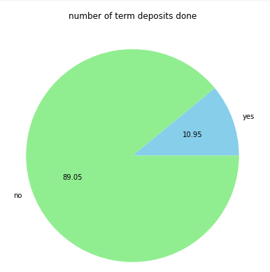
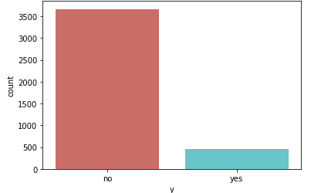
Analysing the percentage of term deposits done
The percentage of people subscribed is 10.95 which is pretty low and the people who did not subscribe is 89.05%

Slide 7
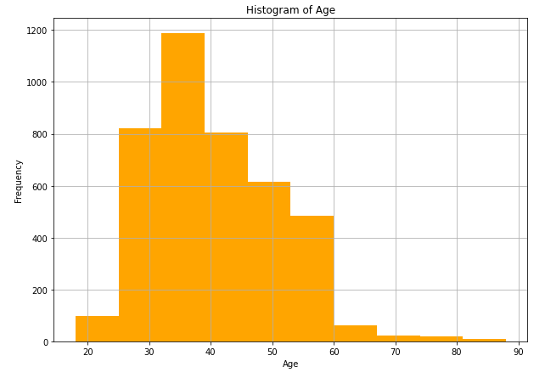
Age groups frequently contacted
From the histogram it is clear that middle aged people from age 30-45 are frequently contacted

Slide 8
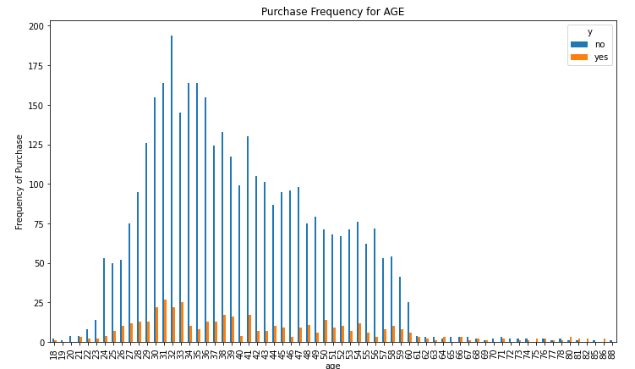
Analysing the relation between age and purchase frequency of subscription

Slide 9
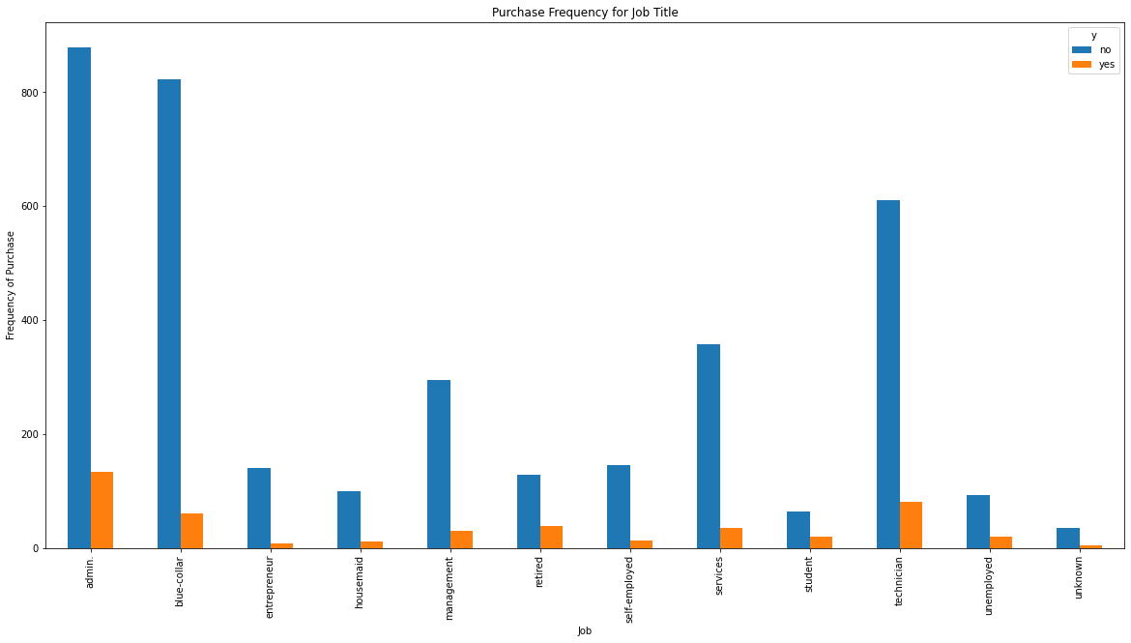
Analyzing the purchase frequency of job title

Slide 10
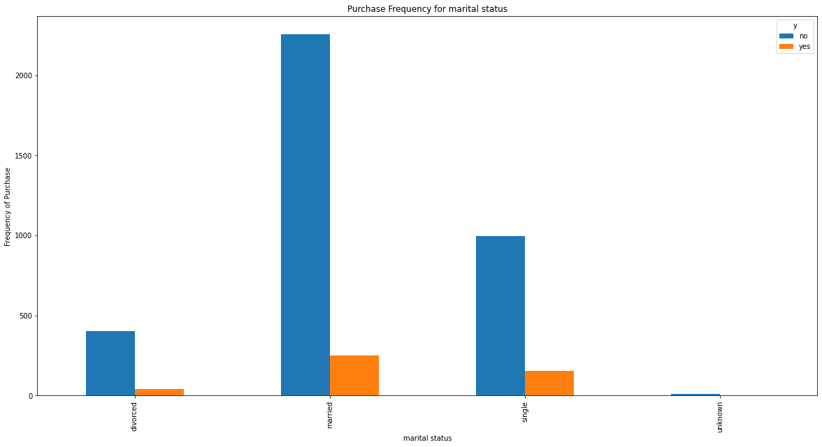
Analyzing the purchase frequency of marital status

Slide 11
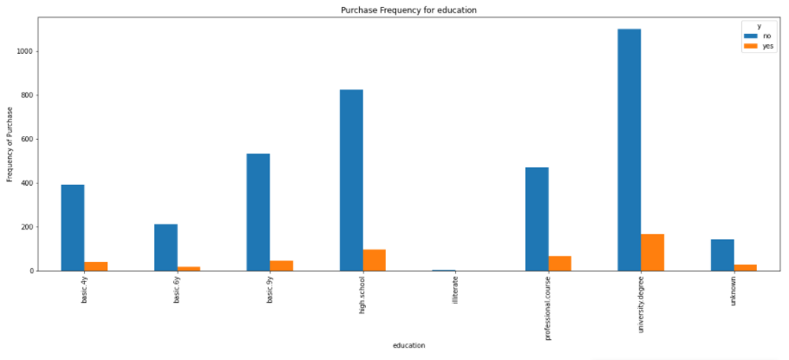
Analyzing the purchase frequency of education

Slide 12
Take away from the graphs:
Middle aged people are showing much interest in term deposit rather than the youth and elderly people.
People holding jobs like admin, blue collar and technician are interested in subscribing the term deposit.
People qualified in high school or university are most likely to subscribe the term deposit.

Slide 13
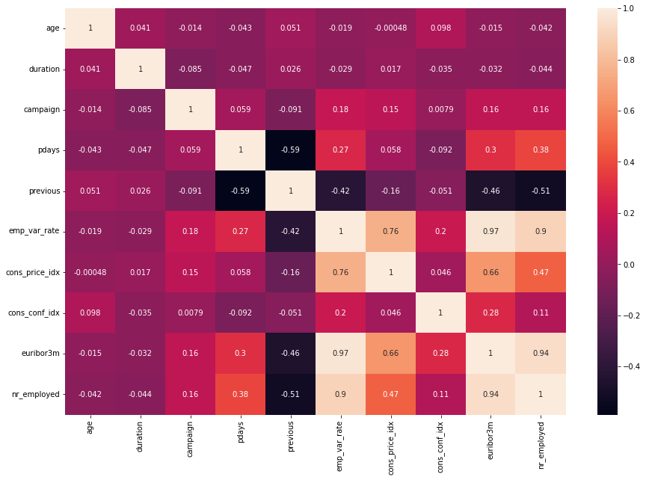
Heat Map
It seems no feature is heavily correlated with other features

Slide 14
Algorithms:
The outcome is a binary dependent variable
Depending on the response: Categorical
Therefore logistic regression is applied.
Train test split method is used to analyze the data
Case1: train : 70%, test : 30%
Case2: train: 80%, test : 20%
X- age, Y- ‘y’

Slide 15

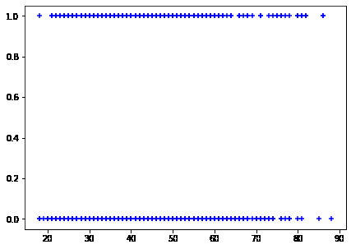
Scatter plot

Slide 16
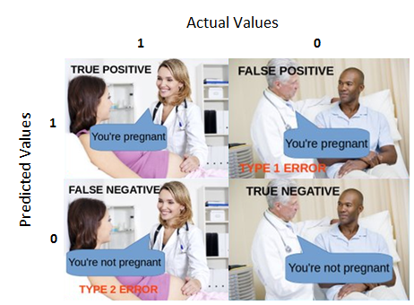
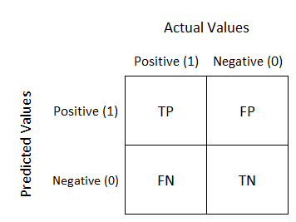
Confusion matrix
It is a table with 4 different combinations of predicted and actual values
True Positive:predicted positive and it’s true
True Negative:predicted negative and it’s true.
False Positive: (Type 1 Error):predicted positive and it’s false.
False Negative: (Type 2 Error):predicted negative and it’s false.

Slide 17
Case1:
train : 70%, test : 30%
Accuracy of logistic regression classifier on test set: 0.901294498381877
[[1114 0]
[ 122 0]]
Confusion matrix :
The table is showing us that we have 1114+0 correct predictions and 122+0 incorrect predictions.

Slide 18
Case2:
train: 80%, test : 20%
Accuracy of logistic regression classifier on test set:
0.9077669902912622
[[748 0]
[ 76 0]]
Confusion matrix :
The table is showing us that we have 748+0 correct predictions and 76+0 incorrect predictions.

Slide 19
K-Fold
K-Fold will provide train/test indices to split data in train and test sets. It will split dataset into k consecutive folds (without shuffling by default). Each fold is then used a validation set once while the k - 1 remaining folds form the training set (source)
Cross validation score (K-Fold) for the data set :
0.8905074378605388

Slide 20
Accuracy:
Number of correct predictions/Total number of predictions
Precision :
The precision is the ratio tp / (tp + fp).
Recall :
The recall is the ratio tp / (tp + fn).
F-beta score :
The F-beta score can be interpreted as a weighted harmonic mean of the precision and recall, where an F-beta score reaches its best value at 1 and worst score at 0.
The F-beta score weights the recall more than the precision by a factor of beta. beta = 1.0 means recall and precision are equally important

Slide 21

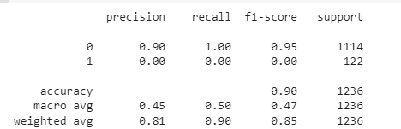
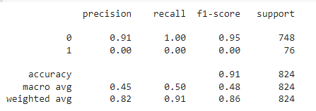
CASE 1:
CASE 2:

Slide 22
Summary & Recommendations
Depending upon the EDA, its better for the bank to prioritize the customers who are middle aged (25-40).
Contacting unmarried people will also help in getting more number of subscribers.
by contacting these type of people, the business might have a chance of getting more and more subscribers.

Slide 23

Github references
G . Paul Abhishek
https://github.com/paulabhishek7777/Capstone-project---UNP
G. Pravalika
https://github.com/PravalikaGivaji/Python_Project
T.Krishna Prasad
https://github.com/TellaKrishnaPrasad/Assignment_UNP_exercise1and2
Pranathi Dehpande
https://github.com/prdeshpande21/unp-team-10
S. Yugender
https://github.com/yugiyugender/capstone-project.git

Slide 24


